Slide 1
Introduction to Software Systems
COMP6710
Assignment 2: HexGame
Jieming Hu (U5841919)

Slide 2
Overview
The objective of the game is to discover the shortest path between two points on the board within a limited time. The game can be played by a single player trying to find the best solution in a limited time, or by multiple players competing to be the first to discover the shortest route.

Slide 3


What we did?
Create interface with JavaFX
Set rules, functions and operations

Slide 4
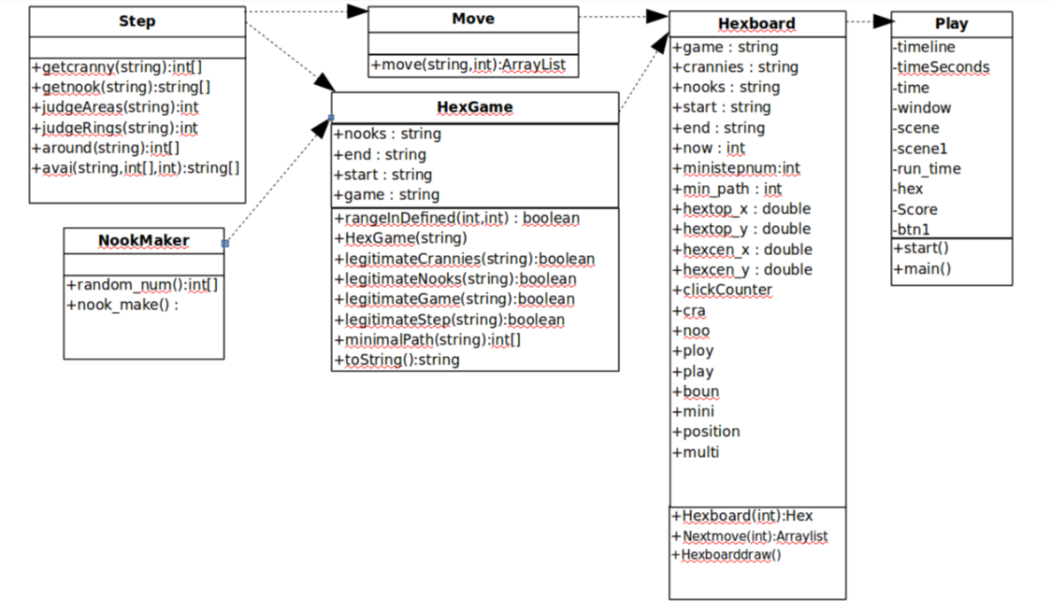
UML Diagram

Slide 5
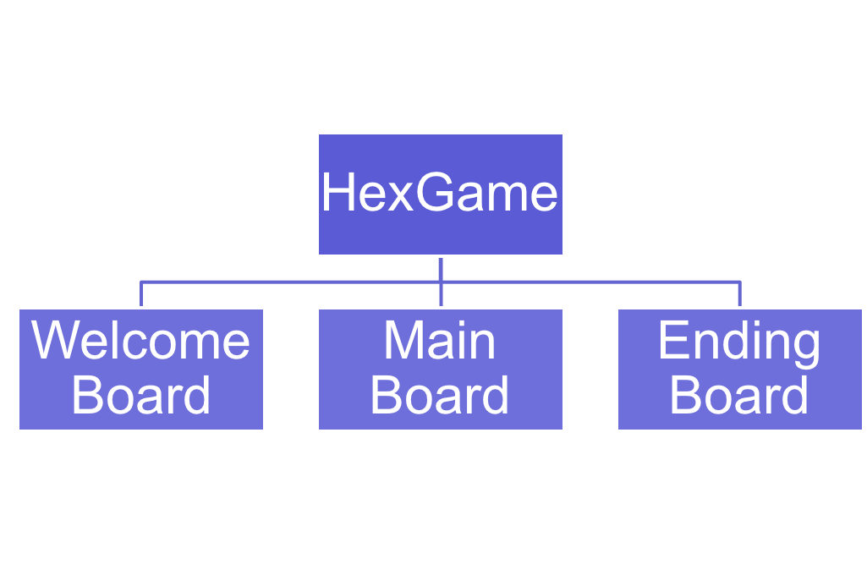
Structure of Our Game

Slide 6
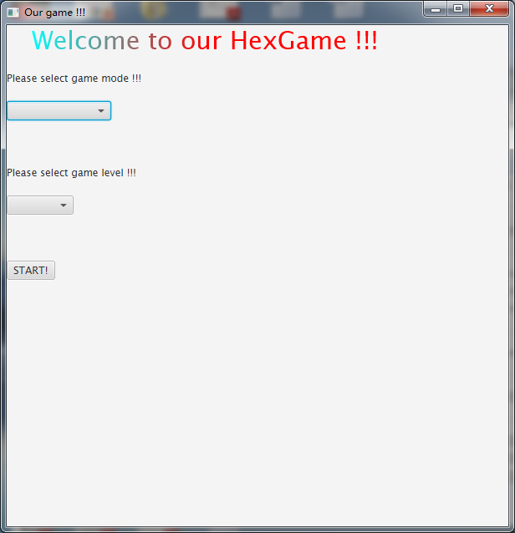
Welcome Board
Game mode (single or multiple player)
Game level (easy, medium or difficult)
Starting button to enter the game

Slide 7
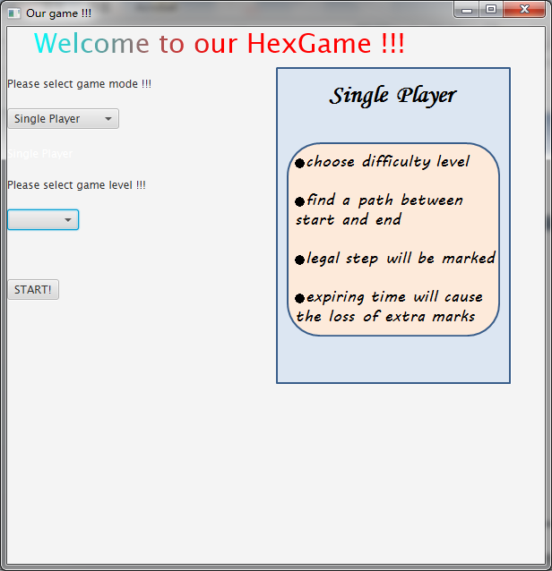
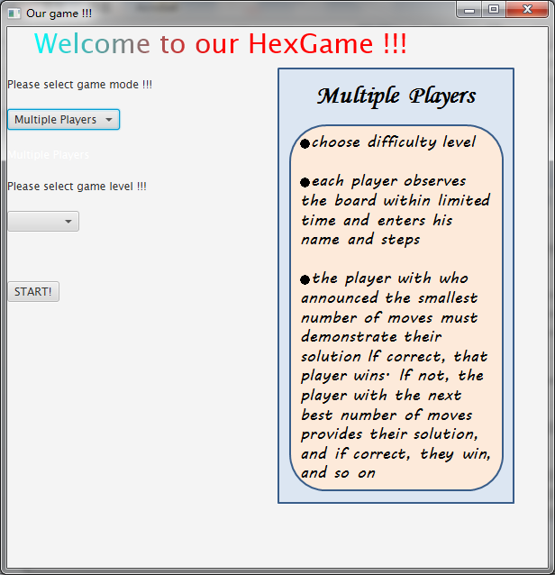
Rules in different modes (will be shown when level selected)

Slide 8
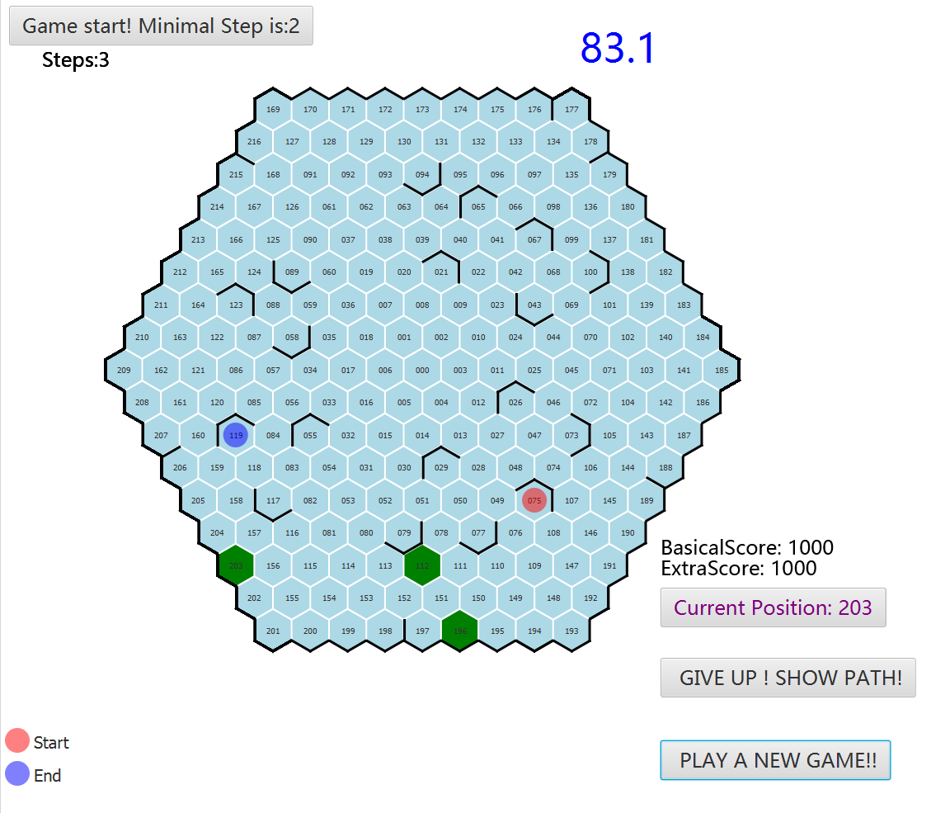
Main Board
show the minimal steps
player’s steps
timer
scores
legal step
last step’s position
illustration of start and end
show optimal solution
restart a new game

Slide 9
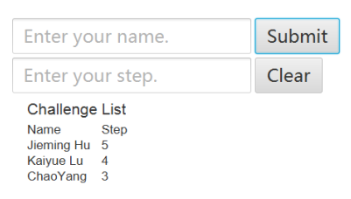
For multiple players

Slide 10
How to find the minimal path
For a specific start and end, using recursive way
  1. Find out which positions are one move from the start
  2. Store the positions
  3. Check whether these position contains end
if contains then find out the minimal path
if not, set the start from these position, back to step 1

Slide 11
How timer works
In single player mode:
You have 150s to play the game. The timer will turn red when it reaches 120s to remind you the time is to be expired. After the time runs out, you cannot get any extra scores.
In multiple players mode:
You have 150s to observe the game and try to find the possible path. During that time, you can not click. After 150s, the competition begins.

Slide 12
Scoring strategy
 | Easy | Medium | Difficulty
Basic Score | 1000 | 2000 | 3000
Extra Score | 1000 | 1000 | 1000
Total(within 150s) | 2000 | 3000 | 4000
Total(out of 150s) | 1000 | 2000 | 3000
Not solve | 0 | 0 | 0

Slide 13
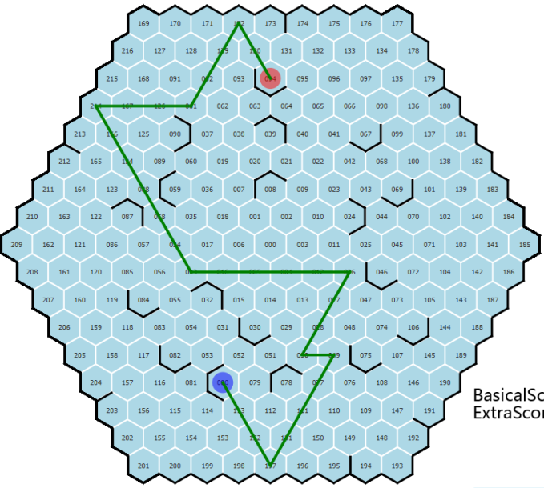


Show path button

Slide 14

New game button

Slide 15

Ending Board

Slide 16
Highlights
★Comfortable interface
★Support single and multiple player modes
★Set different levels
★Reasonable scoring strategy
★Useful hints throughout the game
★Complete game process

Slide 17

Q&A

